Slide 1
College Event Website
Group 12

Slide 2
Group 12
Andrew Mendoza – Back end
William Wilhite – Front end
Andrew McKenzie – Database design

Slide 3
College Event Website
A website to facilitate college events hosted by Student Organizations for both public and private audiences.
Allow for the creation of new events and comment style discussion of the events.

Slide 4
Technical Details
Back End
MySQL
PHP, SLIM
Front End
AngularJS
Bootstrap
Google Maps API

Slide 5
Database Layout

Slide 6
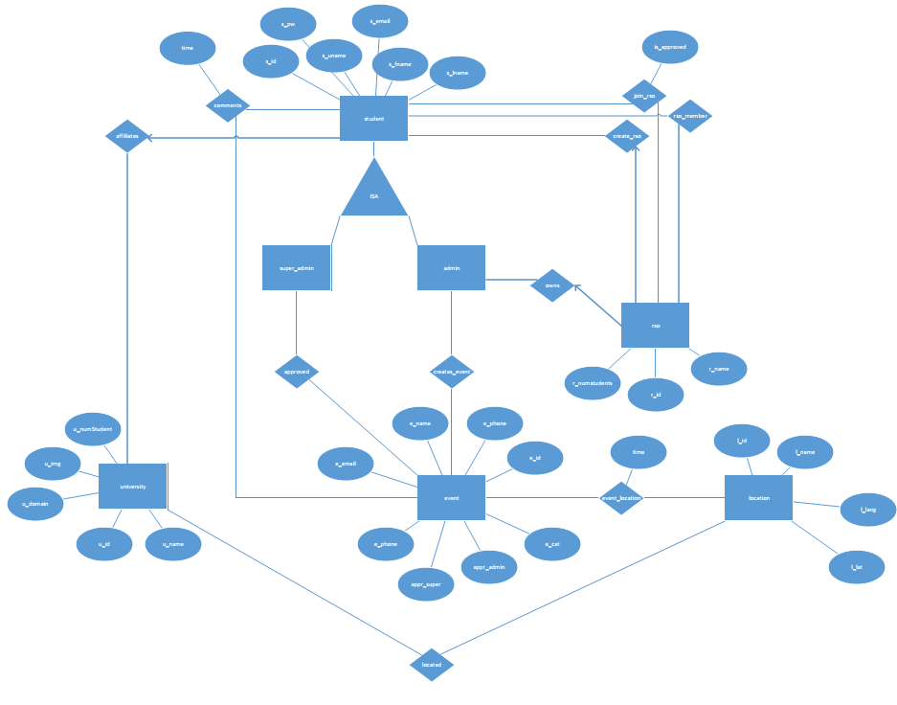

Slide 7
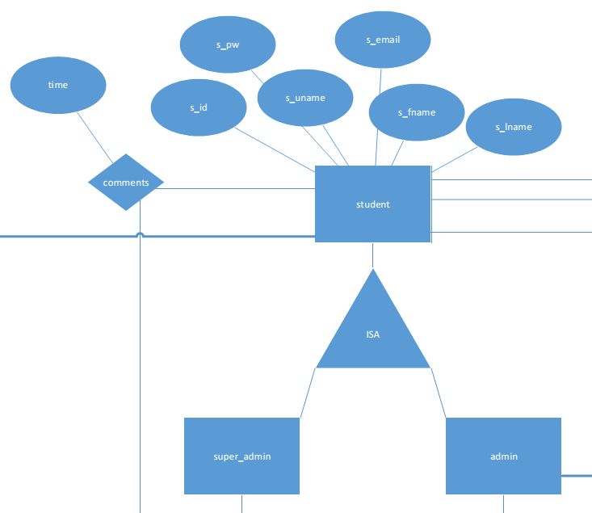

Slide 8
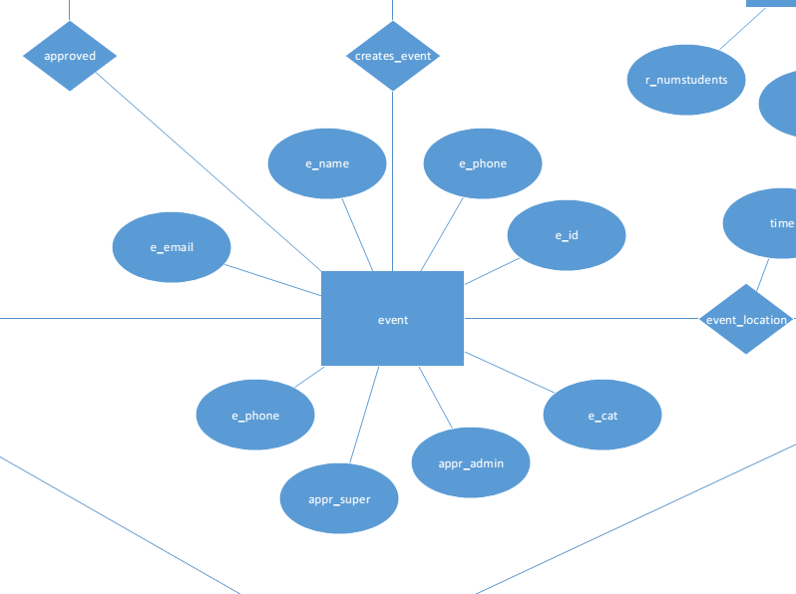

Slide 9
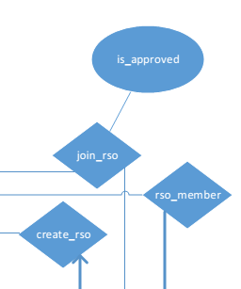
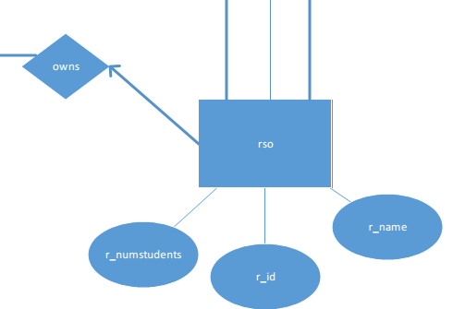

Slide 10
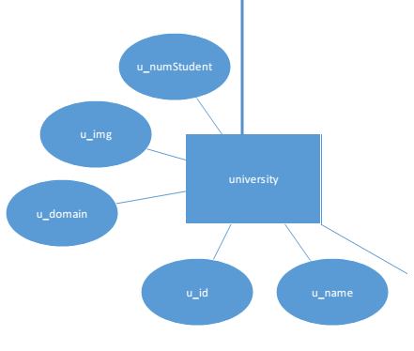

Slide 11
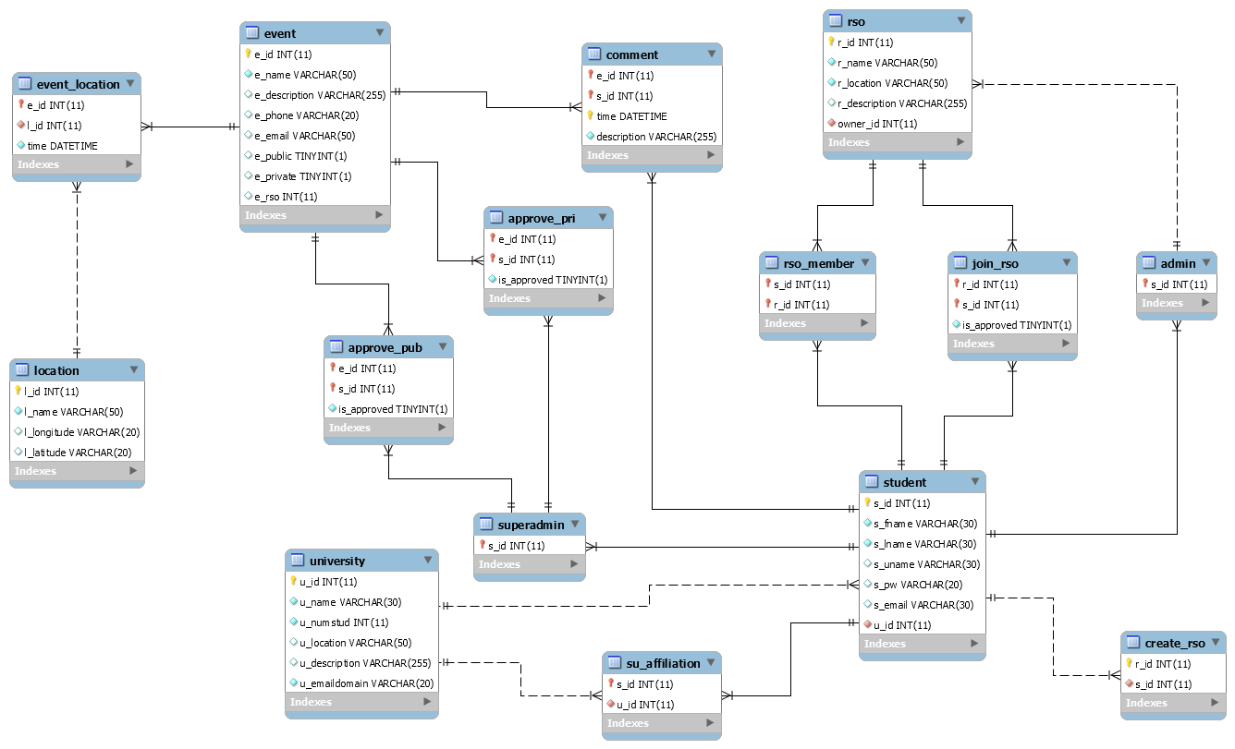

Slide 12
MySQL Creation
CREATE TABLE student(
s_id int(11) NOT NULL AUTO_INCREMENT,
s_fname varchar(30) NOT NULL,
s_lname varchar(30) NOT NULL,
s_uname varchar(30),
s_pw varchar(20),
s_email varchar(30),
u_id int(11) NOT NULL,
PRIMARY KEY (s_id),
FOREIGN KEY (u_id) REFERENCES university(u_id) ON DELETE CASCADE,
UNIQUE (s_uname),
UNIQUE (s_email)
);

Slide 13
MySQL Insert
INSERT INTO `eventwebsite`.`student` (`s_id`, `s_fname`, `s_lname`,
`s_uname`, `s_pw`, `s_email`, `u_id`)
VALUES ('5', 'First', 'Last', 'FL5', '123', 'FL5@knights.ucf.edu', '1');
INSERT INTO `eventwebsite`.`comment` (`e_id`, `s_id`, `time`, `description`)
VALUES ('1', '4', '2015-7-11 06:15:12', 'Text for comment');

Slide 14
AngularJS and Bootstrap

Slide 15
REST api, SLIM, php
GET
POST
SLIM use

